Slide 1
Qt Quick Application Start with Qt
V1.0

Slide 2
Let’s achieve this
Where to get Qt ?
What need to build Qt Application ?
What is Qt Creator ?
Qt Framework

Slide 3
Where to get Qt ?
Qt Installer can get from link: https://www.qt.io/download
Version:
Open Source: it is free !!!
Commercial: it is not free !!!
We can get many supports from Qt company with commercial version.

Slide 4
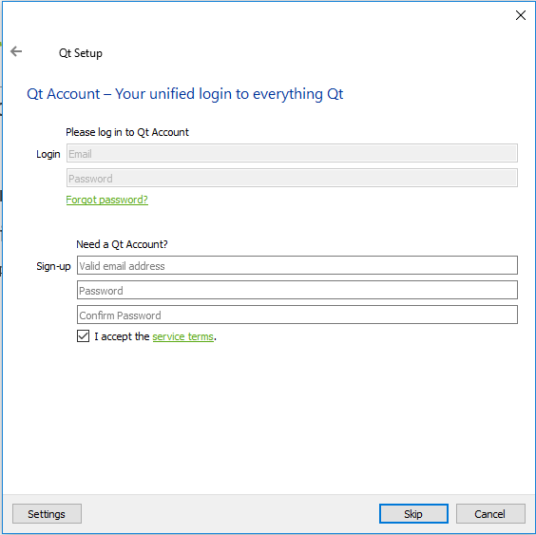
Where to get Qt ?
1. Account setting
“Skip” it if we use open-source version
Change “Settings” if we use internet connection with proxy

Slide 5
Where to get Qt ?
1. Account setting
“Skip” it if we use open-source version
Change “Settings” if we use internet connection with proxy

Slide 6
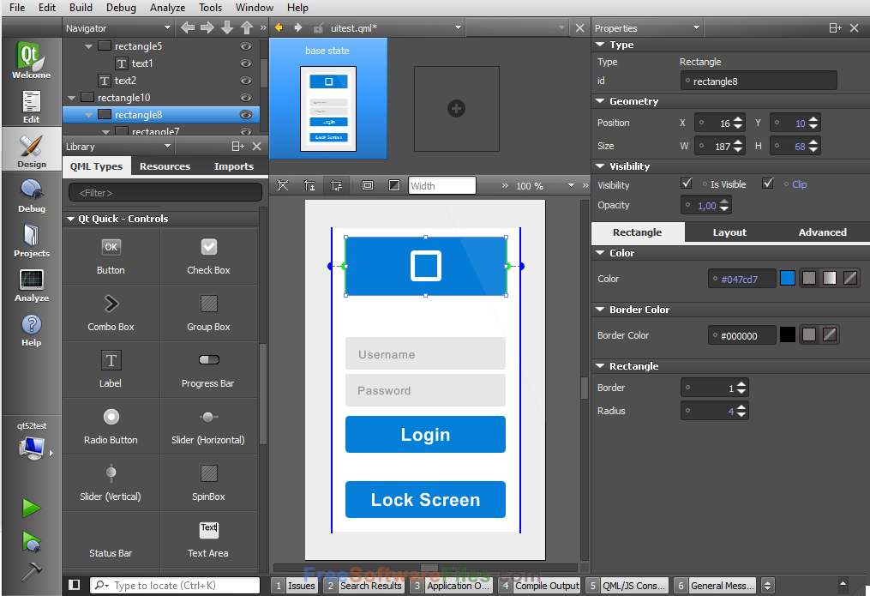
What need to build Qt Application ?
Qt Creator: this tool help us code & design UI for application
Qt Framework: libraries, header files, plugin, etc… for development

Slide 7
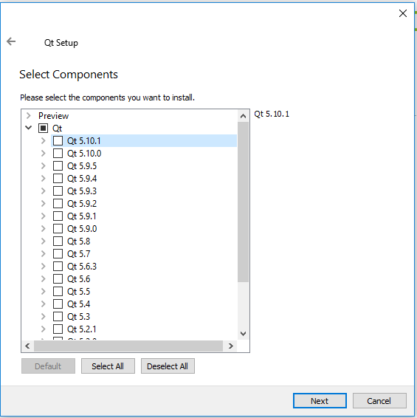
What need to build Qt Application ?
Preview => It is for preview only, don’t care
Qt => All Qt components
Q t <Version>
MSVC 2013 64 Bit
…
MinGW 5.3.0 32 bit
…
Android x86
Android ARMv7
Source => Source code of Qt framework
Qt <Extra module name> => Extra module
(Installed if needed)
…
Tools
Compiler & framework

Slide 8
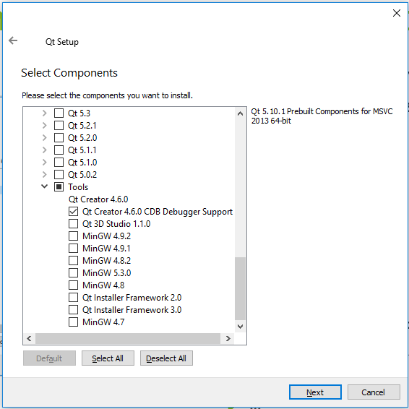
What need to build Qt Application ?
Preview
Qt
Q t <Version>
…
Tools
Qt Creator <Version> => Qt Creator
(default)
Other tools
Note: When we use commercial version, there are tools that we can not use because of license type (standard / development). If we have commercial license, please confirm it with license manager before using

Slide 9


Setup Qt (For window)
Download installer
Click “Skip”
Click “Next”
Click “Finish”
Happy Qt coding !!

Slide 10
What is Qt Creator ?
Qt Creator is a tool help us code & design UI for application

Slide 11
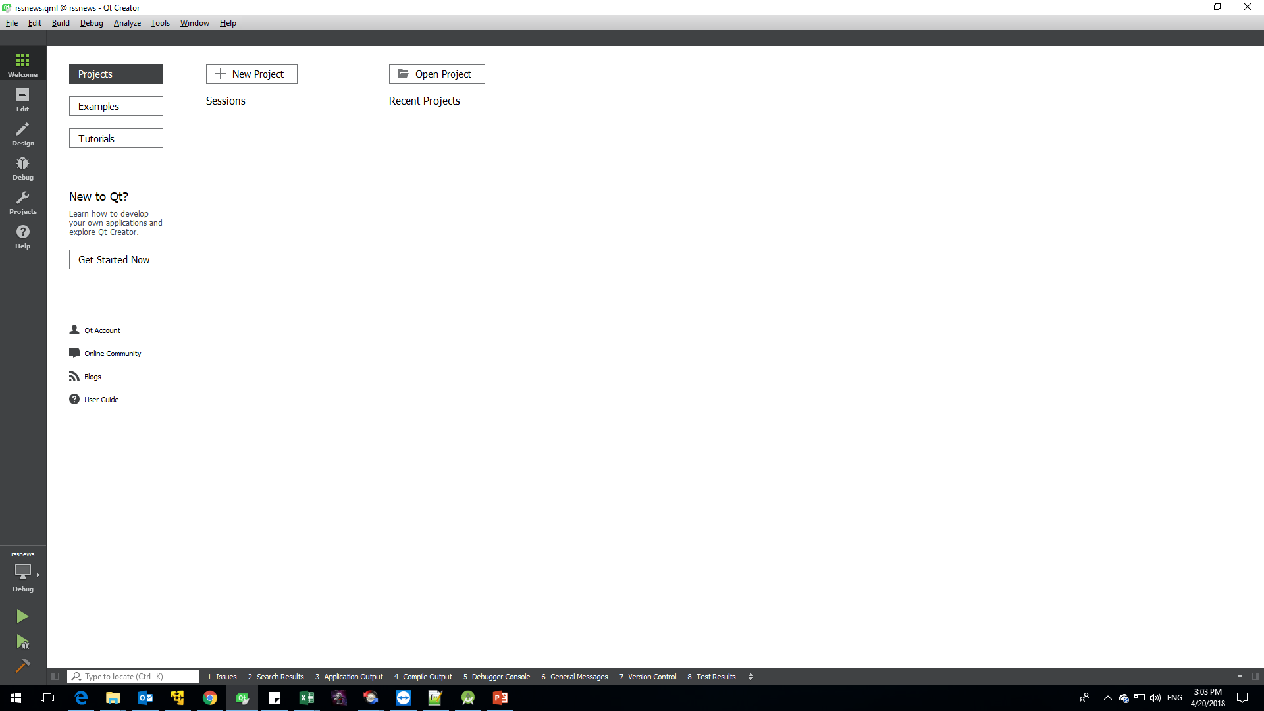
Welcome screen: manage projects overview
Edit screen: view source code of project
Design screen: view design of project
Debug screen: view source code of project (include some debug window)
Projects screen: view setting of project
Help screen
Select build setting for projects
Run project (include output debug log)
Debug project
Build project

Slide 13
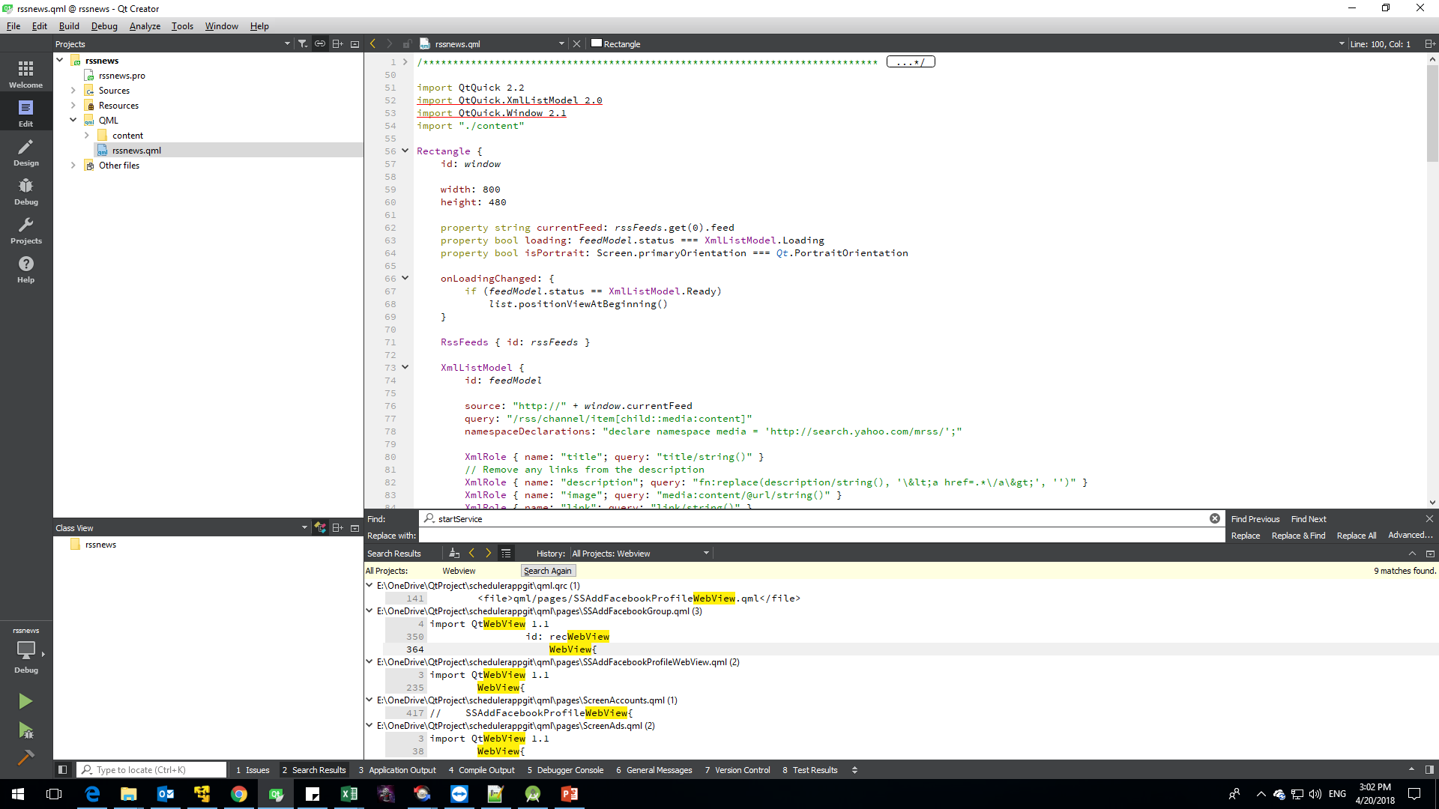

Slide 14
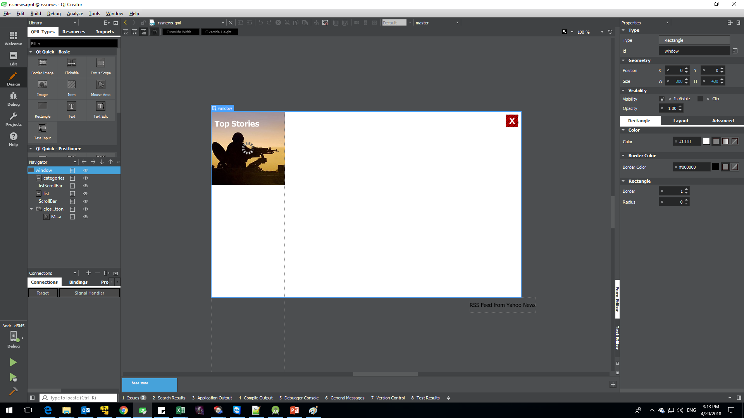

Slide 15
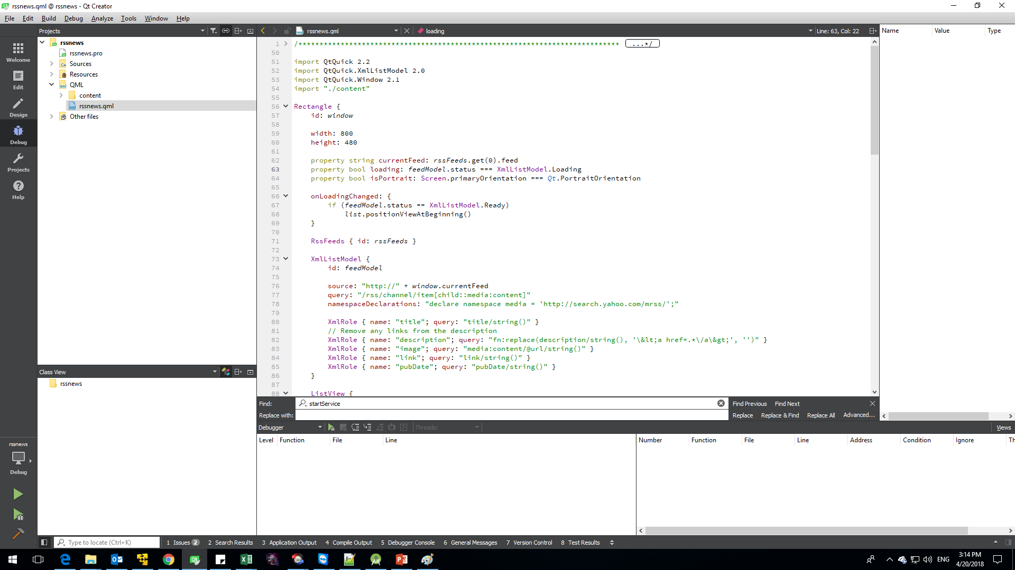

Slide 16
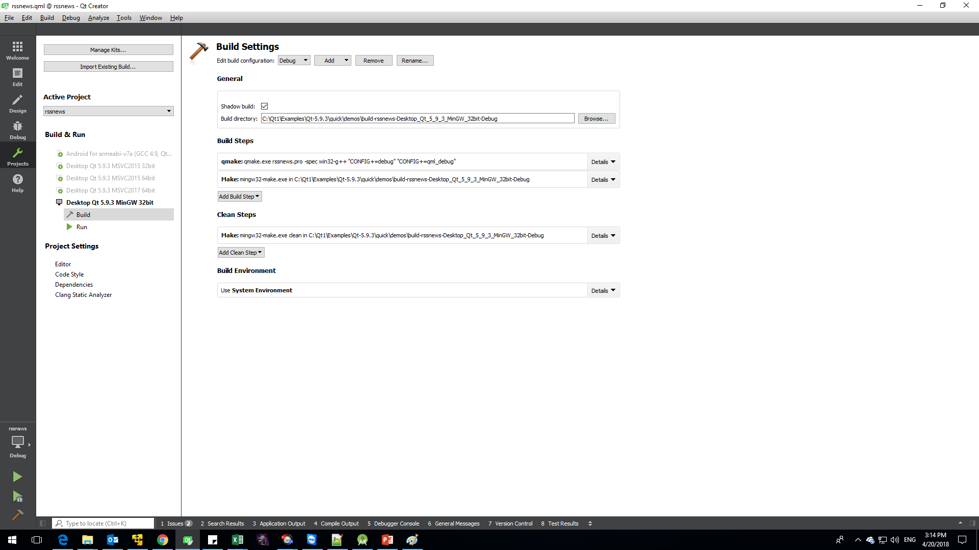
Project build kits
Each kits include many setting of projects. For example: Qt version, Compiler, Debugger, Devices, etc

Slide 17
